Slide 1

Advanced Functionality
By: Munish Arora
Munish.arora@gmail.com

Slide 2
Power-BI Intermediate | Advanced
In this, we will cover
Fuzzy Logic
Importing from Excel Report in Pivot format
Grouping and Binning
Drillthrough
Page drillthrough
Row Level Security

Slide 3

Fuzzy Matching
In short, Fuzzy Matching is an algorithm for approximate string matching
Ice cream
Ice creme
Ice cream
frozen yogurt
Ice lolly
Earlier Power BI only gave us the option (natively) to do Merge / JOIN operations where we can only do exact matches. With Fuzzy Matching, we can do now “close” or “approximate” matches.

Slide 4
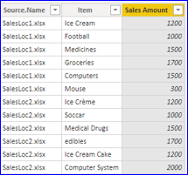
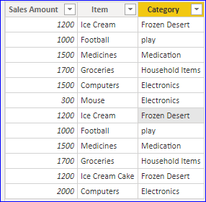
Demo: Fuzzy Matching
Use Fuzzy Logic to find matching names and display category
Item | Category
Ice Cream | Frozen Desert
Medicines | Medication
Groceries | Household Items
Football | play
Computers | Electronics
Ice Cream Cake | Frozen Desert
Mouse | Electronics

Slide 5
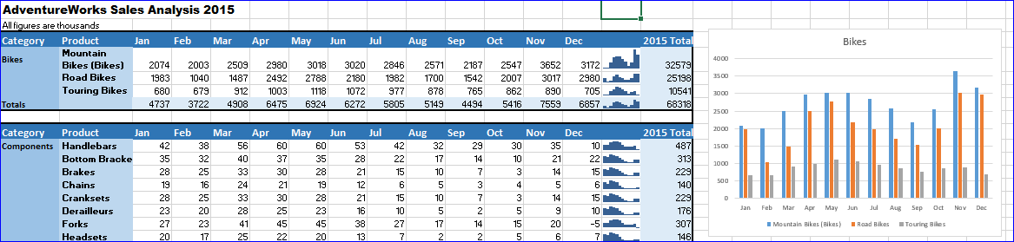
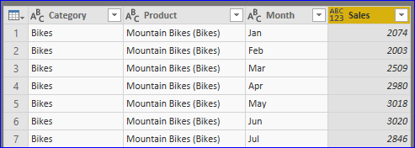
Demo: Import from Report
Import data from Pivot report in Excel to Power BI
Remove
all Blank Rows, All rows with Totals
Column showing 2015 Total
And imported data appears as follows

Slide 6
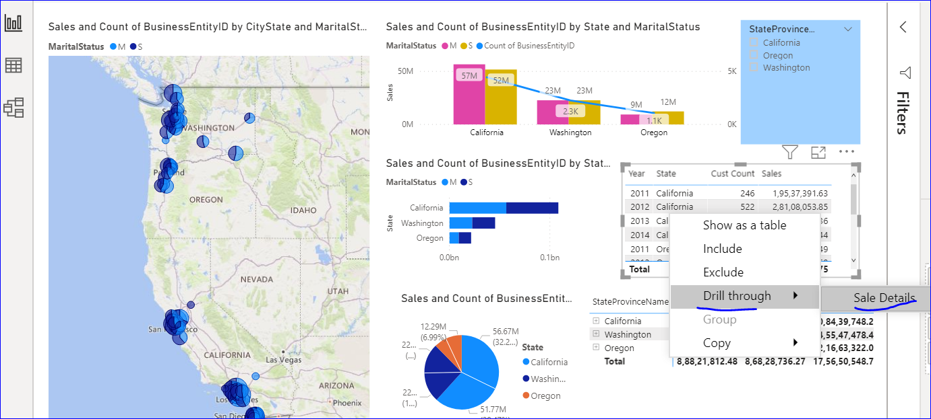
Demo: Drillthrough
1 Drillthrough
1.1 To another page in same report

Slide 7
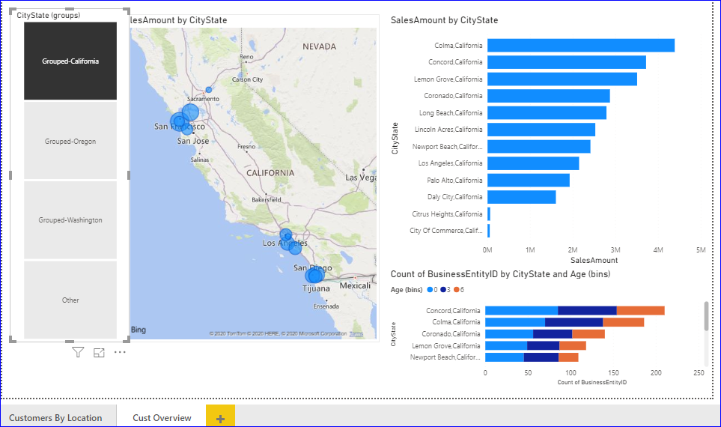
Demo: Grouping And Binning
Grouping and Binning
Group the Cities from Respective States to view data for selected Group
Binning – Aggregate the data into Equally Sized Groups
Displaying Custom Legend

Slide 8


Knowledge Check
The drill through function in Power BI lets you select a value in a visual and drill through to a different page showing the details for the value you have selected
True
False
Which of the following is true
With grouping in Power BI Desktop, you can group visuals together in your report, such as buttons, textboxes, shapes, images, and any visual you create, just like you group items in PowerPoint.
Binning, also called discretization, is a technique for reducing the cardinality of continuous and discrete data.
You can set the bin size for numerical and time fields in Power BI Desktop.
You can set the bin size for text fields in Power BI Desktop.

Slide 9
Row Level Security
Row-Level Security enables you to use group membership or execution context to control access to rows in a database table.
In Row Level Security, you create a role. Thereafter you associate a filter criteria (similar to where clause in SQL Query) with this role
This role can then be assigned to a user. When this user will view this report, then this filter will get applied on the data being shown in dashboard /report
So, Row-level security (RLS) with Power BI can be used to restrict data access for given users.

Slide 10
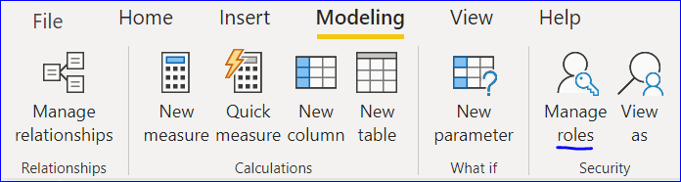
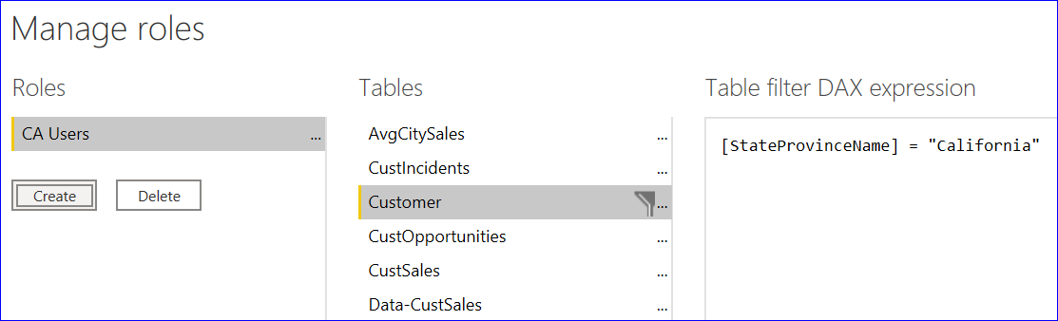
Row Level Security
You create a role, and to this role you add a filter

Slide 11
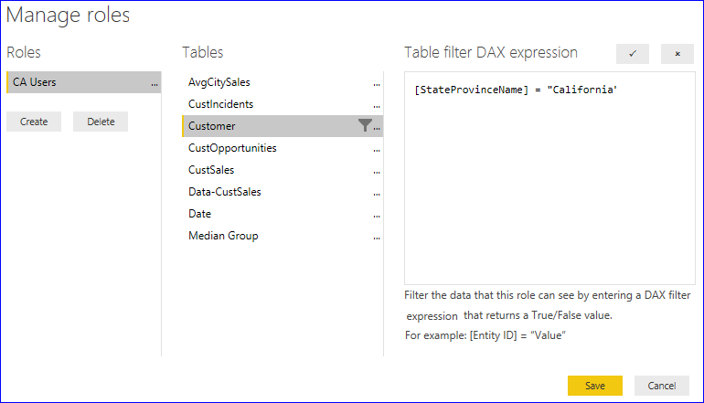
Row Level Security
With Row Level Security, you create a role, and to this role you add a filter

Slide 12
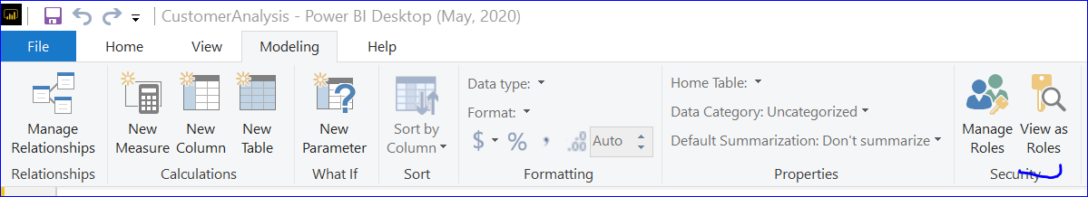
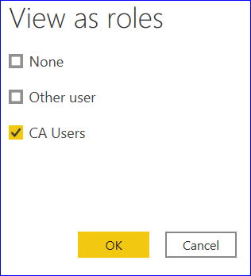
Row Level Security
There-after, you can click on view as role, and data in report will be filtered based on the selection

Slide 13
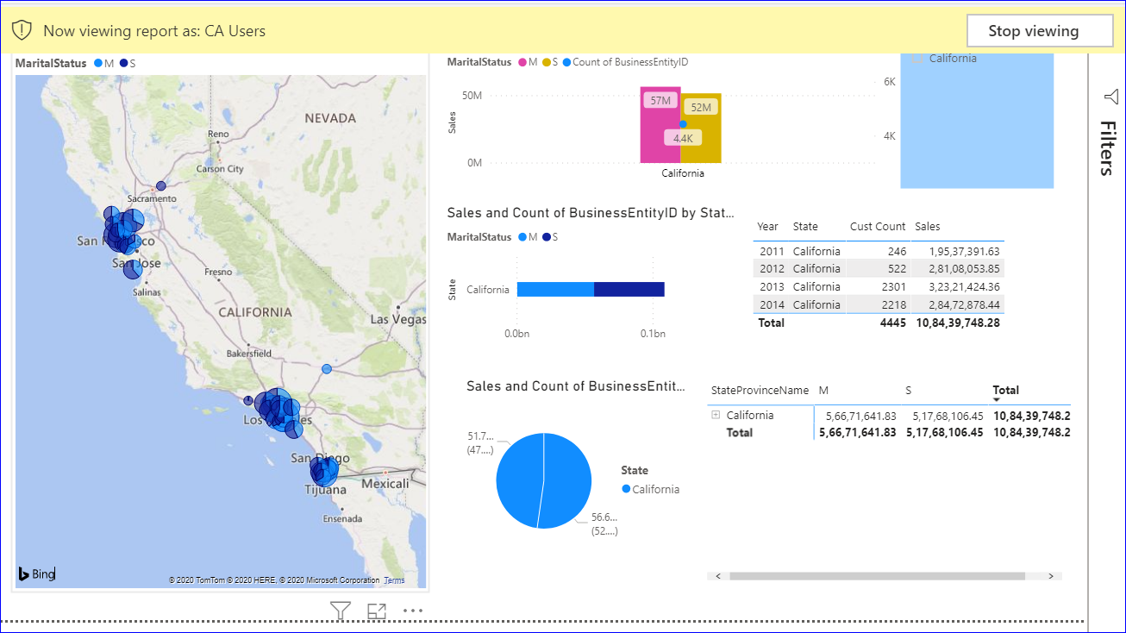
Row Level Security
And it will appear as follows

Slide 14
Row Level Security
Further, when the report is deployed on report server, the role created in this report can be assigned to other users /user group

Slide 15
Knowledge Check
Which of the following is true?
Row-level security (RLS) with Power BI can be used to restrict data access for given users
Filters restrict data access at the row level, and you can define filters within roles.
Star Schema supports setting row access policies on the base table and views.
Snowflake does not support setting row access policies on the base table and views.

Slide 16
Knowledge Check
The drill through function in Power BI lets you select a value in a visual and drill through to a different page showing the details for the value you have selected
True
False
Which of the following is true
With grouping in Power BI Desktop, you can group visuals together in your report, such as buttons, textboxes, shapes, images, and any visual you create, just like you group items in PowerPoint.
Binning, also called discretization, is a technique for reducing the cardinality of continuous and discrete data.
You can set the bin size for numerical and time fields in Power BI Desktop.
You can set the bin size for text fields in Power BI Desktop.

Slide 17
THANK YOU!

